Slide 1
Unit III
Graphs
Dept of Computer Engineering, Dr. D. Y. Patil Institute of Technology, Pune

Slide 2
Contents
Basic concepts
Operations
Graphs storage structures
Traversals: Depth First and Breadth First.
Graph algorithm
Graph as an ADT
Minimum spanning trees: Kruskal’s and Prim’s.
Algorithm for shortest path
Topological sorting

Slide 3
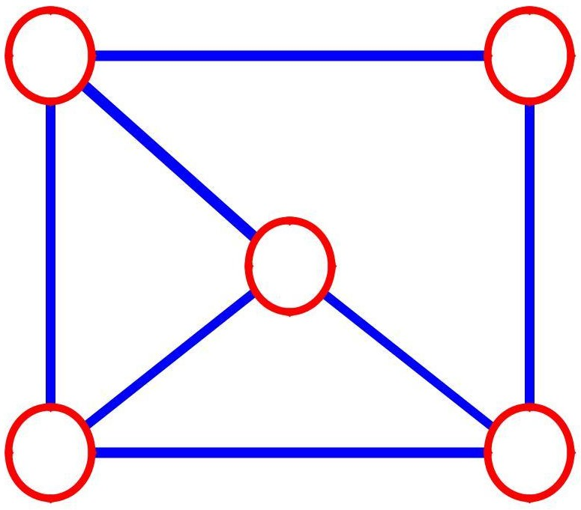
What is a Graph?
A graph G = (V,E) is composed of: V: set of vertices
E: set of edges connecting the vertices in V
An edge e = (u,v) is a pair of vertices
Example:
a b
V= {a,b,c,d,e}
c | E= {(a,b),(a,c),(a,d),(b,e),(c,d),
 | (c,e),(d,e)}
d
e
3

Slide 4



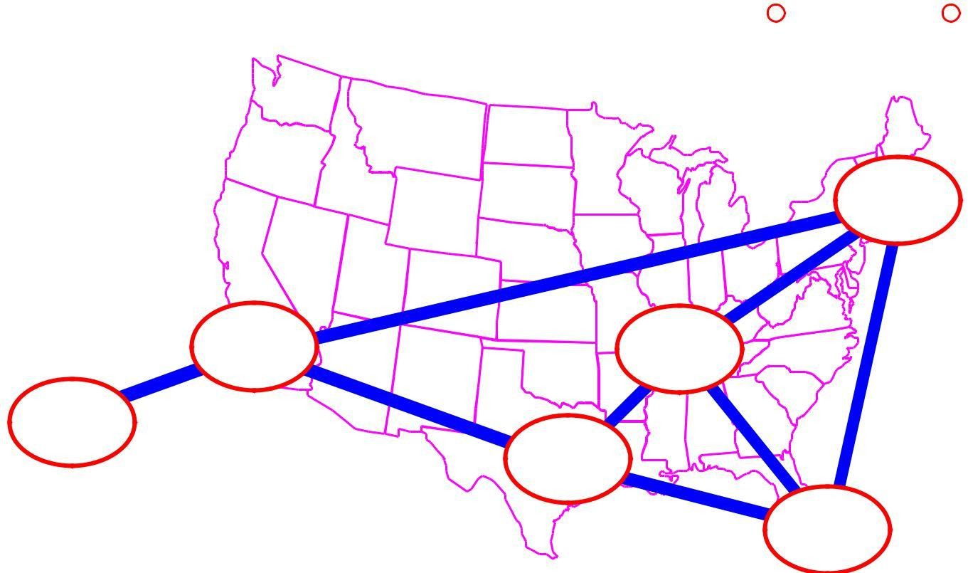
◼ Networks (roads, flights, communications)
Applications |  | CS16
◼ Electronic circuits
JFK
LAX | STL
HNL | FTL | 4
DFW

Slide 5
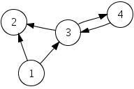
Types of Graph
Directed Graph (diagraph)
Each line has a direction to its successor
These lines are known as arcs
The flow along the arcs between two vertices can follow only the indicated direction
5

Slide 6
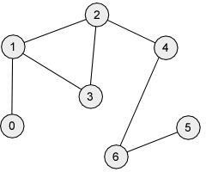
Types of Graph
Undirected Graph
No direction on any of the line, which are known as edges.
The flow between two vertices can go in either direction
6

Slide 7
Directed vs. Undirected Graph
An undirected graph is one in which the pair of vertices in a edge is unordered, (v0, v1) = (v1,v0)
A directed graph is one in which each edge is a directed pair of vertices, <v0, v1> != <v1,v0>
tail
head
7

Slide 8
Terminology: Adjacent and Incident
If (v0, v1) is an edge in an undirected graph,
v0 and v1 are adjacent
The edge (v0, v1) is incident on vertices v0 and v1
If <v0, v1> is an edge in a directed graph
v0 is adjacent to v1, and v1 is adjacent from v0
The edge <v0, v1> is incident on v0 and v1
8

Slide 9
Terminology: Degree of a Vertex
The degree of a vertex is the number of edges incident to that vertex
For directed graph,
the in-degree of a vertex v is the number of edges that have v as the head
the out-degree of a vertex v is the number of edges that have v as the tail
if di is the degree of a vertex i in a graph G with n
vertices and e edges, the number of edges is
n−1
=( )/
e ∑ di 2
0
Why?
Since adjacent vertices each count the adjoining edge,
it will be counted twice

Slide 10
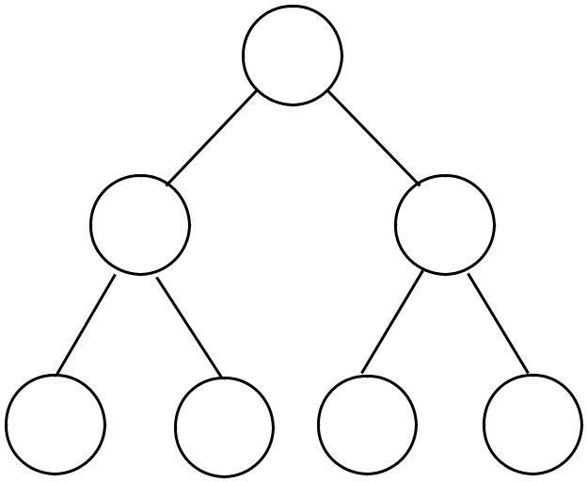
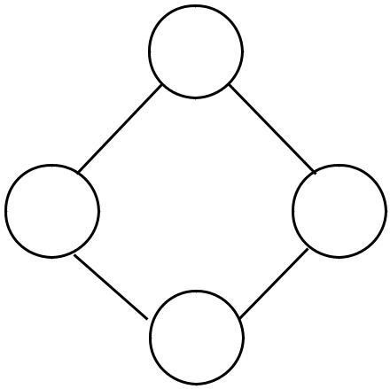
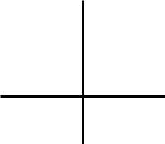
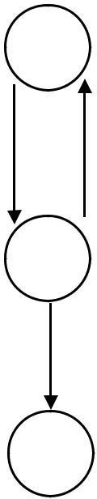
Examples
0
3
0
1 | 2 | 2
3 |  | 3
3 | 4 | 5 | 6
1 | 1 | 1 | 1
3 1
2 3
3 3
G1
G2
0 in:1, out: 1
directed graph in-degree out- degree
1 in: 1, out: 2
2 in: 1, out: 0
G3
10

Slide 11
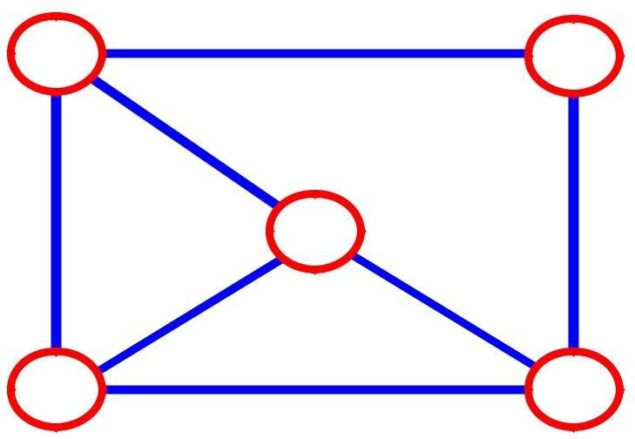
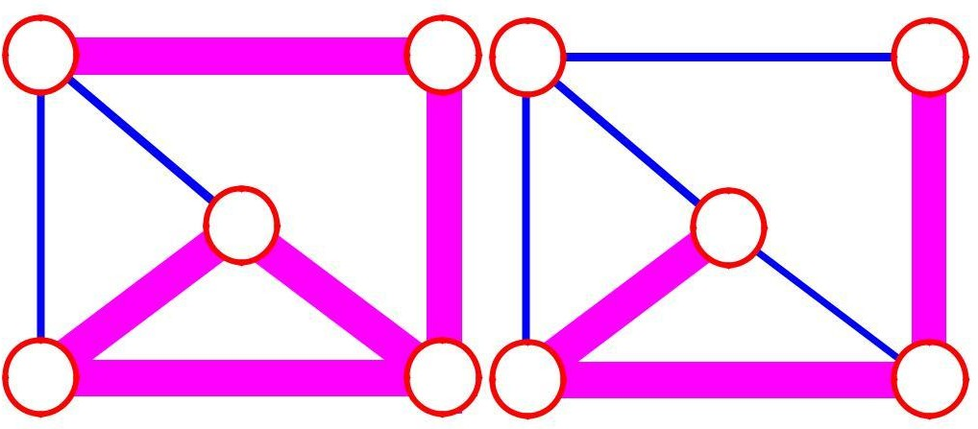
Terminology: Path
◼ Path: is a sequence of vertices v1,v2,. . .vk such that each vertex is adjacent to each other.
3 | 2
3
3
3
a
b a
b
c | c
d | e d | e
a b e d c | b e d c
11

Slide 12
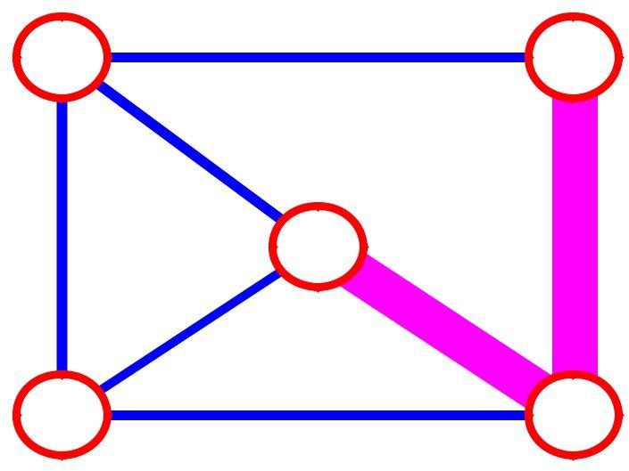
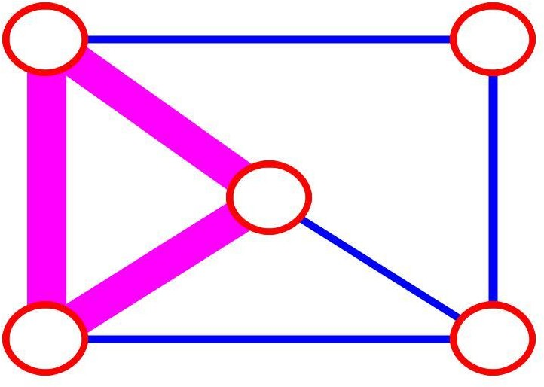
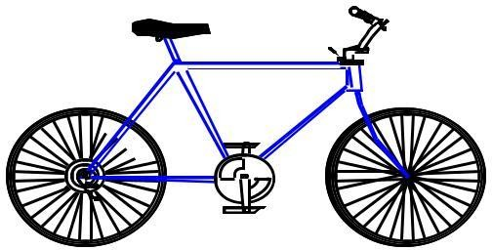
More Terminology
◼ Simple path: no repeated vertices
a
b
b e c
c
d e
◼ Cycle: simple path, except that the last vertex is the same
a
as the first vertex
b
a c d a
c
d
e
12

Slide 13
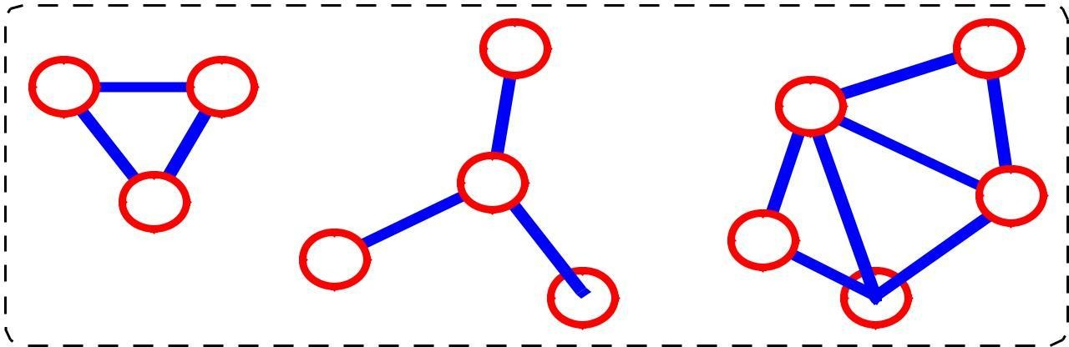
More Terminology
◼ Subgraph: subset of vertices and edges forming a graph
13

Slide 14
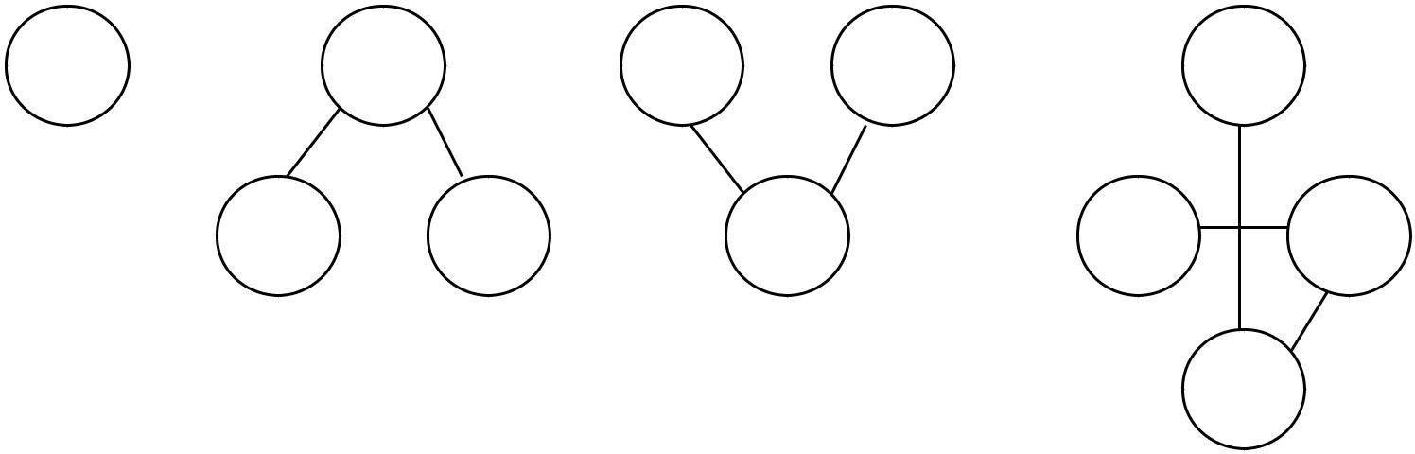
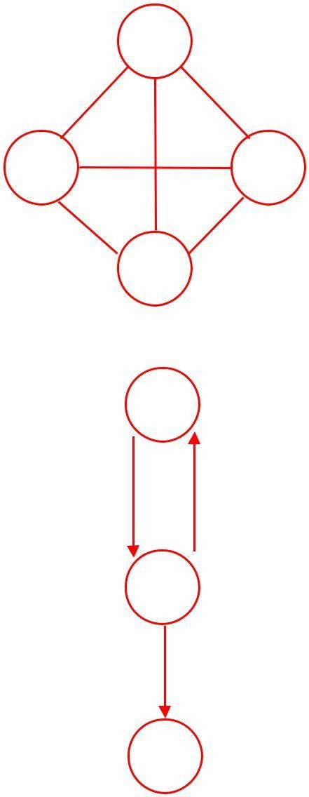
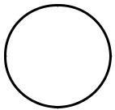
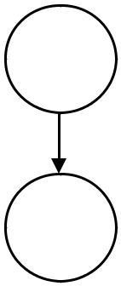
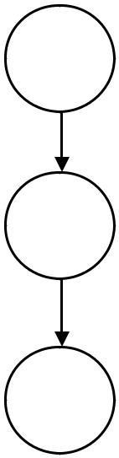
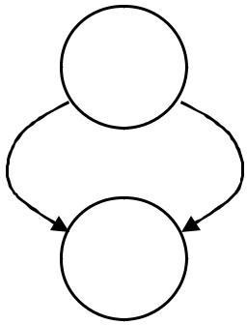
Subgraphs Examples
0 | 0 | 0 | 1 | 2 | 0
 | 1 | 2 | 3 | 1 | 2
1 | 2
3 |  |  |  |  | 3
G1 | (i) | (ii) | (iii) |  | (iv)
0 | (a) Some of the subgraph of G1
 | 0 | 0 | 0 |  | 0
1 |  | 1 | 1 |  | 1
2
2
2
(iv)
(i)
(ii) (iii)
(b) Some of the subgraph of G3
G3
14

Slide 15
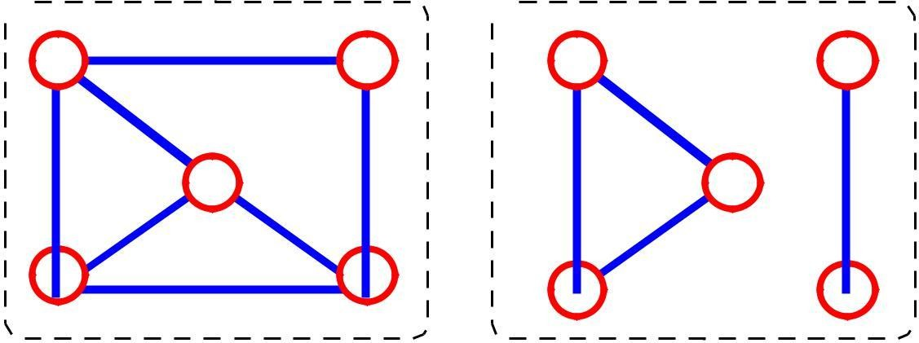
Connected graph
Two vertices are said to be connected if there is a path between them.
A graph is said to be connected if ignoring direction there is a path from any vertex to any other vertex any two vertices are connected by some path
connected not connected
15

Slide 16
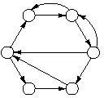
Strongly Connected Graph
◼ A directed graph is strongly connected if there is a path from each vertex to every other vertex in the diagraph
16

Slide 17
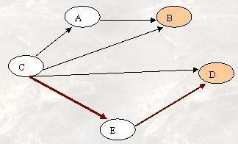
Weakly connected graph
◼ A graph is a weakly connected if at least two vertices are not connected.
◼ Disjoint Graph?
17

Slide 18
More…
Tree - Connected graph without cycles
A tree is a graph in which each vertex has only one predecessor, however a graph is not a tree
18

Slide 19
ADT for Graph
objects: a nonempty set of vertices and a set of undirected edges, where each edge is a pair of vertices
functions: for all graph ∈ Graph, v, v1 and v2 ∈ Vertices
Graph Create()::=return an empty graph
Graph InsertVertex(graph, v)::= return a graph with v inserted. v
has no
incident edge.
Graph InsertEdge(graph, v1,v2)::= return a graph with new edge
between v1 and v2
Graph DeleteVertex(graph, v)::= return a graph in which v and
all edges
incident to it are removed
Graph DeleteEdge(graph, v1, v2)::=return a graph in which the
edge (v1, v2)
is removed
Boolean IsEmpty(graph)::= if (graph==empty graph) return TRUE
else return FALSE
List Adjacent(graph,v)::= return a list of all vertices that are adjacent to
v | 19

Slide 20
Operations
Insert a vertex
Delete a vertex
Add an edge
Delete an edge
Find a vertex
Traverse a graph
20

Slide 21
Graph Storage structure (Representations)
Sequential :Adjacency Matrix Linked list: Adjacency Lists
Requires two sets: Vertices
Edges and arcs
21

Slide 22
Adjacency Matrix
Vector for vertices
Matrix for edges
22

Slide 23
Adjacency Matrix
Let G=(V,E) be a graph with n vertices.
The adjacency matrix of G is a two-dimensional n by n array, say adj_mat
If the edge (vi, vj) is in E(G), adj_mat[i][j]=1
If there is no such edge in E(G), adj_mat[i][j]=0
The adjacency matrix for an undirected graph is symmetric; the adjacency matrix for a digraph need not be symmetric
23

Slide 24
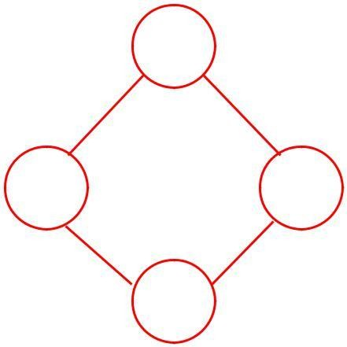
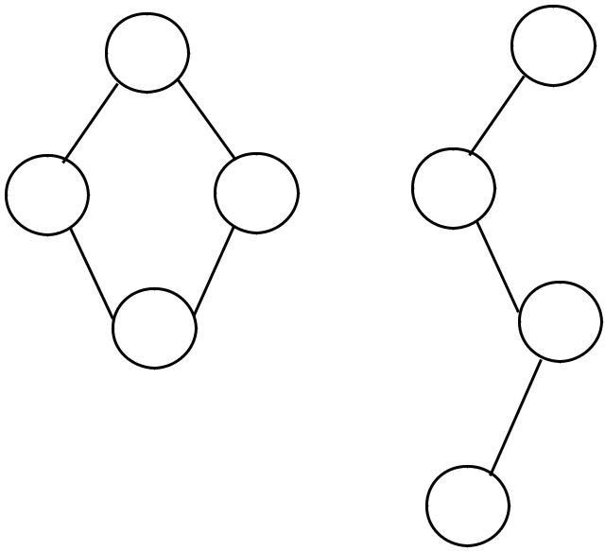
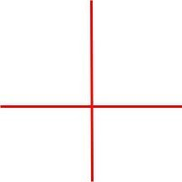
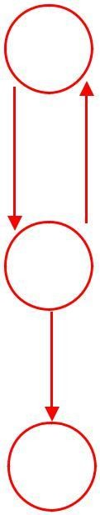
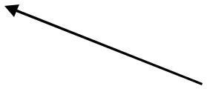

Examples for Adjacency Matrix
0
0
2
1
 | 3
0 | 1 | 1
1 | 0 | 1
[1¹ | 11 | 10
1
1 |  |  | [0 | 1 | 0 | ]
1
 | ] |  | 1 | 0 | 1
1 |  | 2 | 0 | 0 | 0
0
G 2
G
1
symmetric
Sp nee to rep graph is
bits.
About halfspacecanbesavedincase of undirected grap hbystoringeit herupper o r lower trianglei.e.n 2/2

Slide 25
1 | 0
24

Slide 26
Merits of Adjacency Matrix
From the adjacency matrix, to determine the connection of vertices is easy
 | n−1
The degree of a vertex is | ∑ adjmat | i | j
 | j=0
For a digraph (= directed graph),
the row sum is the outdegree, while the column sum is the indegree
n−1
n−1
ind ( vi)=∑ A [ j ,i ]
j=0
outd (vi )=∑ A [ i , j ]
j =0

Slide 27
Limitations of Adjacency Matrix
The number of vertices must be known in advance.
Only one edge can be stored between any two vertices.

Slide 28
Adjacency Lists
Each row in adjacency matrix is represented as an adjacency list.
Vertex list is SLL of the vertices in the list

Slide 29
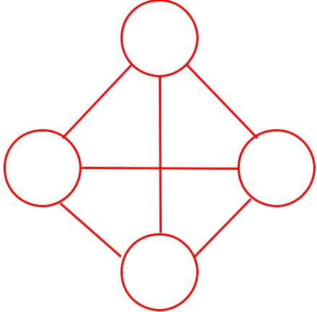




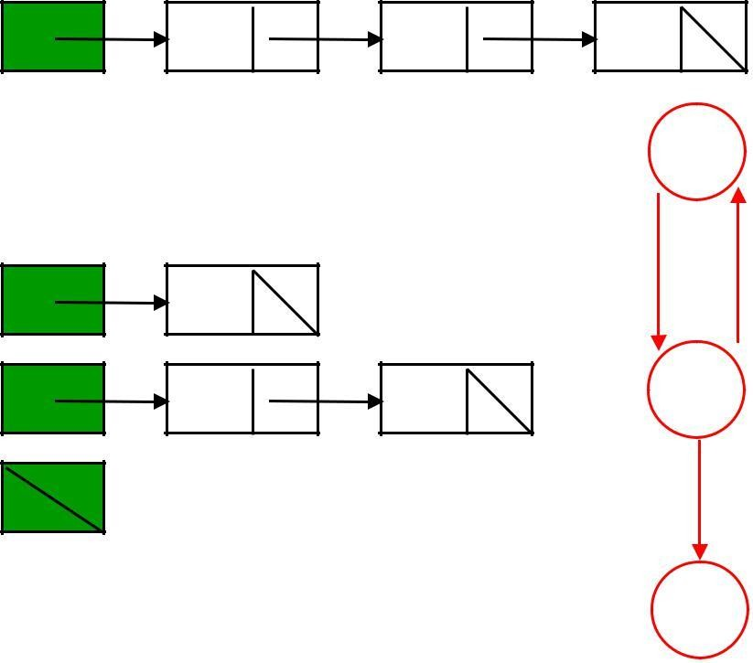
 | 0
1 |  | 2
 | 3
0 | 1 | 2 | 3
1 | 0 | 2 | 3
2 | 0 | 1 | 3
3 | 0 | 1 | 2
 | G1 |  | 0
0 | 1
1 | 0 | 2 | 1
2
 | G2 |  | 2
0
4
2
1
5
3
6
 |  |  | 7
0 | 1 |  | 2
1 | 0 |  | 3
2 | 0 |  | 3
3 | 1 |  | 2
4 | 5
5 | 4 |  | 6
6 | 5 |  | 7
7 | 6 G3
An undirected graph with n vertices and e edges ==> n head nodes and 2e list nodes28

Slide 30
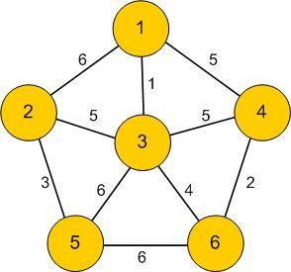
Network
A network is a graph whose lines are weighted. It is also known as weighted graph.
Meaning of weights depend upon the application
For example: graph for Airline routs
29

Slide 31
Minimum Spanning Tree (MST)
A minimum spanning tree is a subgraph of an undirected weighted graph G, such that
it is a tree (i.e., it is acyclic)
it covers all the vertices V
contains |V| - 1 edges
the total cost associated with tree edges is the minimum among all possible spanning trees
30

Slide 32
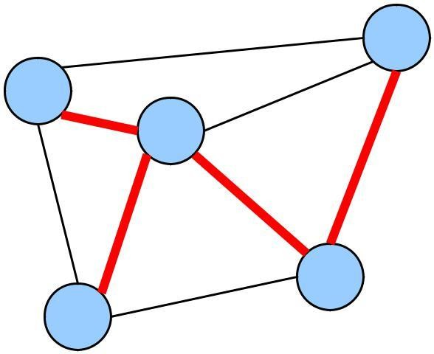
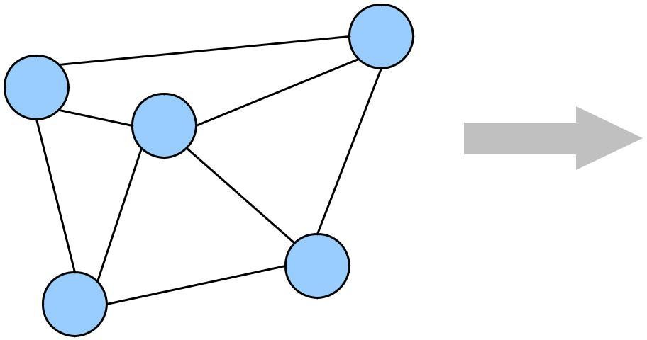
How Can We Generate a MST?
 | 9 |  |  |  |  | 9 |  | b
a | 2 d | 6 | b | a | 2 | d | 6 | 5
 |  |  |  |  |  |  | 4
 |  | 4 | 5 | 5 | 4
5 | 4
 |  |  |  |  |  |  | e
 |  | e |  | c |  | 5
c | 5
From all of the vertices in the tree
select the edge with the minimal value to a vertex not currently in the tree and insert it into the tree

Slide 33
31

Slide 34
MST Algorithms
Prims Algorithm
Kruskal's Algorithm

Slide 35
Kruskal’s algorithm
Builds a minimum cost spanning tree T by adding
edges to T one at a time.
Selects the edges for inclusion in T in increasing order of their cost.
An edge is added to T if it doesn´t form a cycle
with the edges that are already in T.
Since G is connected and has n > 0 vertices, exactly n – 1 edges will be selected for inclusion in T.

Slide 36
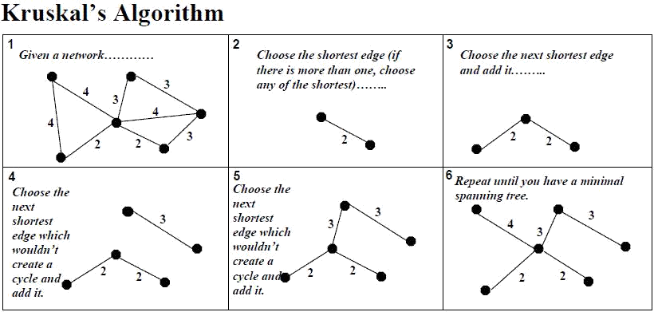

Slide 37
Kruskal’s algorithm
T = ø
While ( (T contains n – 1 edges) && ( E not empty) ) {
choose an edge (v,w) from E of lowest cost;
delete (v,w) from E;
if ( (v,w) does not create a cycle in T)
add (v,w) to T;
else
discard (v,w) 9. }
if (T contains fewer than n – 1 edges)
cout << ¨no spanning tree¨ << endl ;

Slide 38
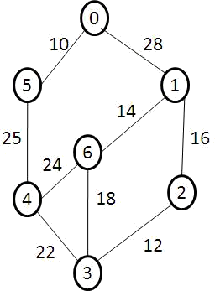

Slide 39
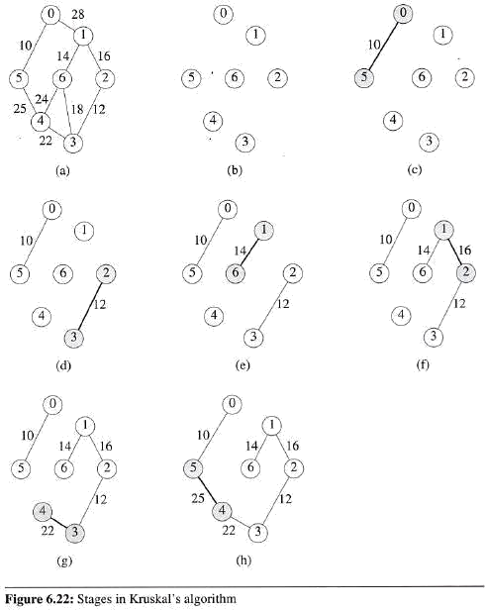
Kruskal’s algorithm
Example:

Slide 40
Prim’s algorithm
Begins with a tree T that contains a single vertex.
This vertex can be any of the vertices in the original graph.
Add a least-cost edge (u, v) to T such that T U { (u, v)
} is also a tree.
This edge-addition step is repeated until T contains n – 1 edges.
Edge (u, v) is always such that exactly one of u and v is in T.

Slide 41
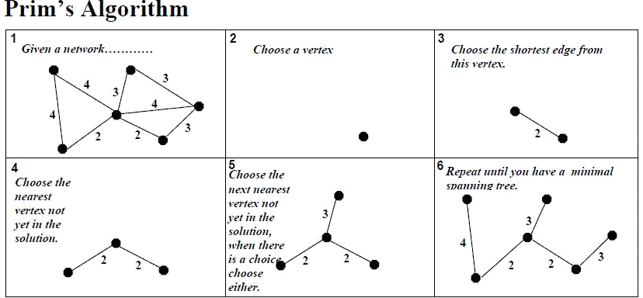

Slide 42
Prim’s algorithm
// Assume that G has at least one vertex.
// start with vertex 0 and no edges 1. TV = {0};
For (T = ø; T contains n – 1 edges;
add (u, v) to T 4. {
Let (u,v) be a least cost edge such that u ϵ TV and v ϵ TV;
if ( there is no such edge )
add v to TV; 8. }
if (T contains fewer than n – 1 edges)
cout << ¨no spanning tree¨ << endl ;

Slide 44
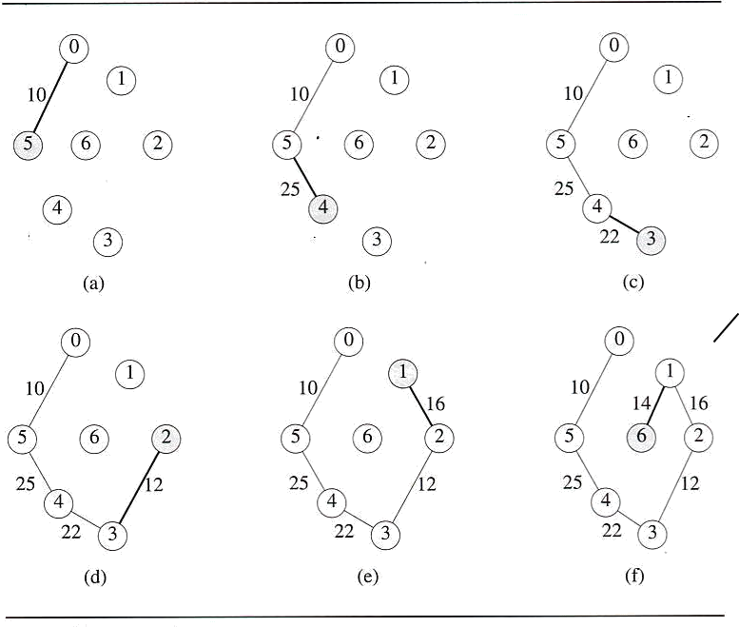
Prim’s algorithm
Example:

Slide 45
What are differences between…..
Prim’s algorithm
http://profesores.elo.utfsm.cl/~agv/elo320/animation/prim/ prim_kruskal.html
Kruskal’s Algorithm

Slide 46
Comparing MST algorithms
Kruskal's Algorithm:
It is an Algorithm in graph theory that finds a minimum spanning tree for a connected weighted graph.
Kruskal is where we order the edges from smallest to largest and pick accordingly.
Kruskal allows both new-new nodes and old-old nodes to get connected.
Kruskal's algorithm builds a minimum spanning tree by adding one edge at a time. The next line is always the shortest only if it does not create a cycle.
Kruskal's require us to sort the edge weight's first.

Slide 47
Comparing MST algorithms
Prim's Algorithm:
It is the Algorithm that finds a minimum spanning tree for a connected weighted undirected graph.
In Prim's algorithm we select an arbitrary node then correct the ones nearest to it.
Prim's always joins a new vertex to old vertex.
Prim's builds a minimum spanning tree by adding one vertex at a time. The next vertex to be added is always the one nearest to a vertex already on a graph.
In Prim's algorithm we select the shortest edge when executing
the algorithm. | 45

Slide 48
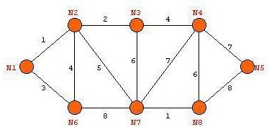
Practice Example:
◼ Find the MST using Prim’s and Kruskal’s Algorithm.

Slide 49
Graph Algorithms
class graph
{
int i,j,n,f,r,v1,v2,top;
int g[10][10],visit[10];
public:
void create(); void display();
void bfs(); void dfs(); graph( );
};

Slide 50
Algorithm Create ()
// algorithm to read input undirected graph from user. 1. {
Read( no of nodes as n);
Repeat()
4. {
5.
6.
7.
8.
9.
Write(“Enter starting and ending vertices”); Read(v1 and v2);
g[v1][v2]=1;
g[v2][v1]=1;
Write(“Do You Want To Enter More Edges ");
10. } until(false);
11. }

Slide 51
Algorithm Display ()
// This algorithm is used to print undirected graph given by user. 1. {
2.
3.
4.
5. }
for( i=1 to n) do for(j=1 to n ) do Write(g[i][j]);

Slide 52
Graph Traversal
DFS:
BFS :

Slide 53
Depth First Traversal
Process vertex’s descendents before moving to an adjacent vertex.
Uses Stack
Begin by pushing the first vertex into the stack
Then loop,
1. pop the stack
after processing the vertex push all the adjacent vertices into the stack
2.
3. When the stack is empty the traversal is complete

Slide 54
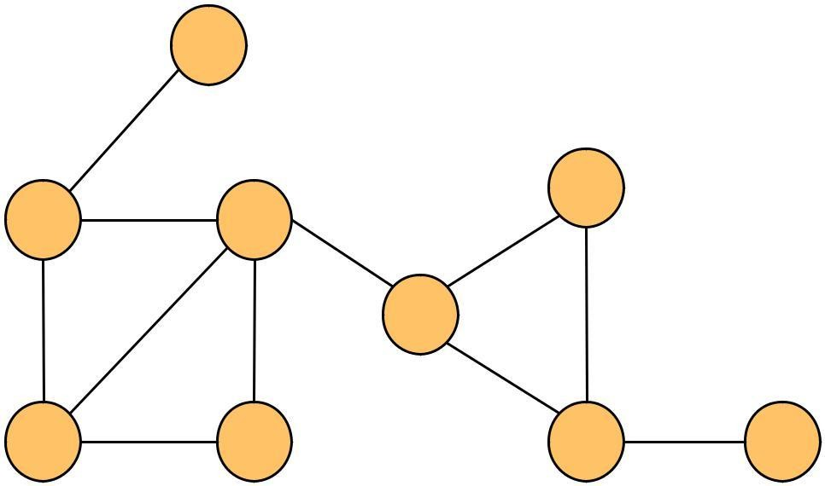
DFS : Example
 |  | 1 A
2 |  | 3 | 6
 |  |  | Y
 | X | H
 |  |  | E
9 |  | P ₄ | 5 |  | 8
 | G |  | M | J
7
Stack Representation ?
A X H P E Y M J G

Slide 55
Algorithm DFS ( ) // This algorithm is used to traverse graph in DFS order.
1. {
2. for(i=1 to n) do
3.
4.
5.
6.
visit[i]=0;
Read(Starting vertex in v1); push(v1);
STACK
while(top!=-1)
// until stack is not empty
7. | {
8. | v1=pop();
9. | if(visit[v1]==0) | // v1 is unvisited
10. | {
11. | Write(v1);
12. | visit[v1]=1;
13. | for(v2=1 to n) | // find neighbors
14. | if(g[v1][v2]==1) |  | // neighbor exist
15. | push(v2);
16. | }
17. | }
18. } |  |  | 53

Slide 56
Breadth First Traversal
Process all adjacent vertices before going to next level.
Uses Queue
We begin by visiting the start vertex v.
Next, all unvisited vertices adjacent to v are visited.
Unvisited vertices adjacent to these newly visited vertices are then visited, and so on.
54

Slide 57
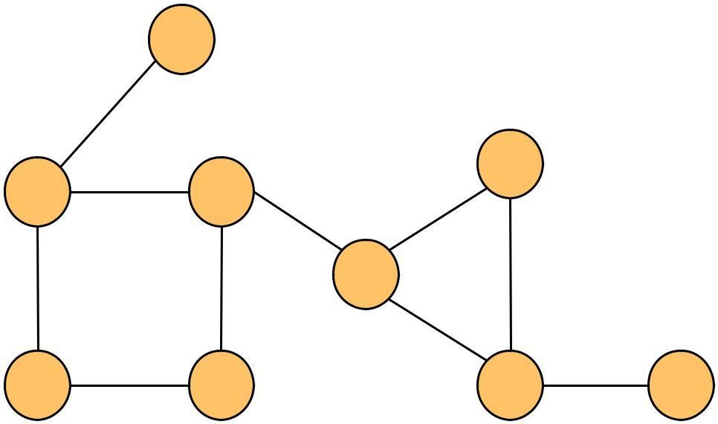
BFS : Example
1
A
4
6
E
Y
8
X
H
2
3 G
P
5
M
7
J
9
◼ Queue Representation ?
A X G H P E M Y J
55

Slide 58
Algorithm BFS( )
// algorithm to traverse given graph in BFS order.
1. {
2.
Read(Starting
vertex in v1);
// All vertices are unvisited.
3.
4.
5.
6.
7. while(f!=r) // till queue is not empty
8. {
9.
10.
11.
12.
for(i=1 to n) do visit[i]=0; add(v1); visit[v1]= 1;
QUEUE
v1=remove(); //queued node Write(v1);
for(v2=1 to n) do
{ //each link of that node if not visited should be added into queue
14. | if(g[v1][v2]==1 && visit[v2]==0)
15. | {
16. | add(v2);
1. | visit[v2]=1;
18. | }
19. | }
20. }
21. }

Slide 59
56

Slide 60
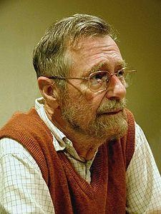
Dijkstra's algorithm:
How to find shortest path
The author: Edsger Wybe Dijkstra
57

Slide 61
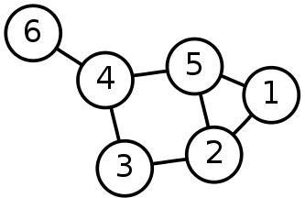
Single-Source Shortest Path Problem
Single-Source Shortest Path Problem - The problem of finding shortest paths from a source vertex v to all other vertices in the graph.
58

Slide 62
Dijkstra's algorithm
◼Dijkstra's algorithm - is a solution to the single- source shortest path problem in graph theory.
◼Works on both directed and undirected graphs.
◼However, all edges must have nonnegative weights. ◼Approach: Greedy
◼Input: Weighted graph G={E,V} and source vertex v∈V, such that all edge weights are nonnegative
◼Output: Lengths of shortest paths from a given source vertex v∈V to all other vertices
59

Slide 63
Dijkstra's algorithm - Pseudocode
dist[s] ←0 //distance to source vertex is zero for all v ∈ V– {s}
do dist[v] ←∞ //set all other distances to infinity S←∅ //S, the set of visited vertices is initially
empty
Q←V //Q, the queue initially contains all vertices while Q ≠∅ //while the queue is not empty
do u ← mindistance(Q,dist) //select the element of Q with the min. distance S←S∪{u} //add u to list of visited vertices
for all v ∈ neighbors[u]
do if dist[v] > dist[u] + w(u, v) //if new shortest path found then d[v] ←d[u] + w(u, v) //set new value of shortest path
return dist
60

Slide 64
Time Complexity: Using List
The simplest implementation of the Dijkstra's algorithm stores vertices in an ordinary linked list or array
◼ Good for dense graphs (many edges)
|V| vertices and |E| edges
Initialization O(|V|)
While loop O(|V|)
Find and remove min distance vertices O(|V|)
Potentially |E| updates
◼ Update costs O(1)
Reconstruct path O(|E|)
Total time O(|V²| + |E|) = O(|V²| )
61

Slide 65
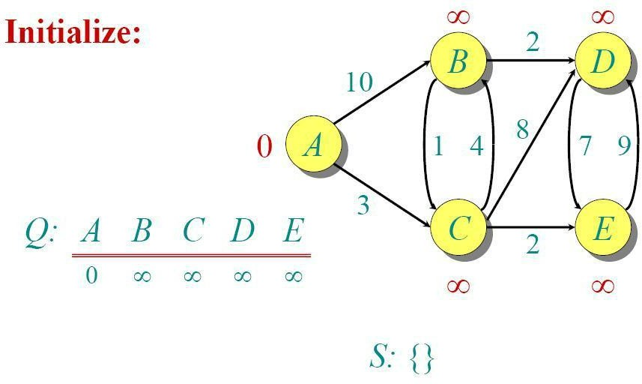
Dijkstra Example
62

Slide 66
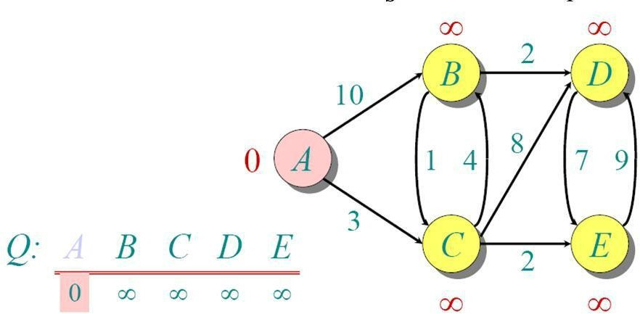
Dijkstra Example
63

Slide 67
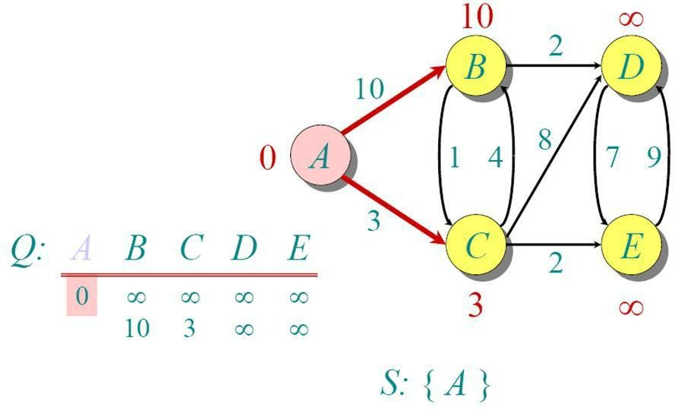
Dijkstra Example
64

Slide 68
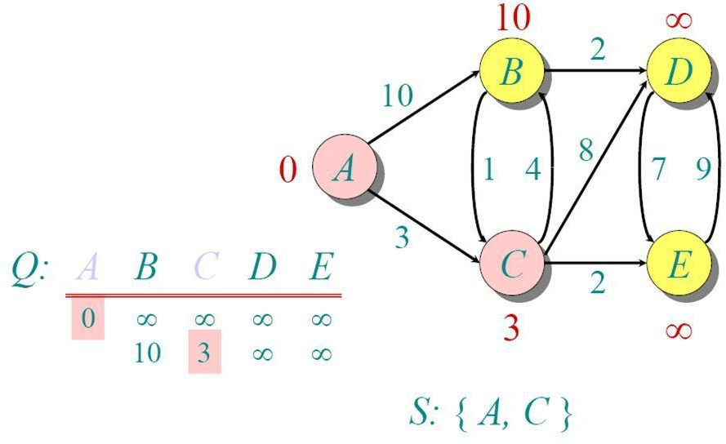
Dijkstra Example
65

Slide 69
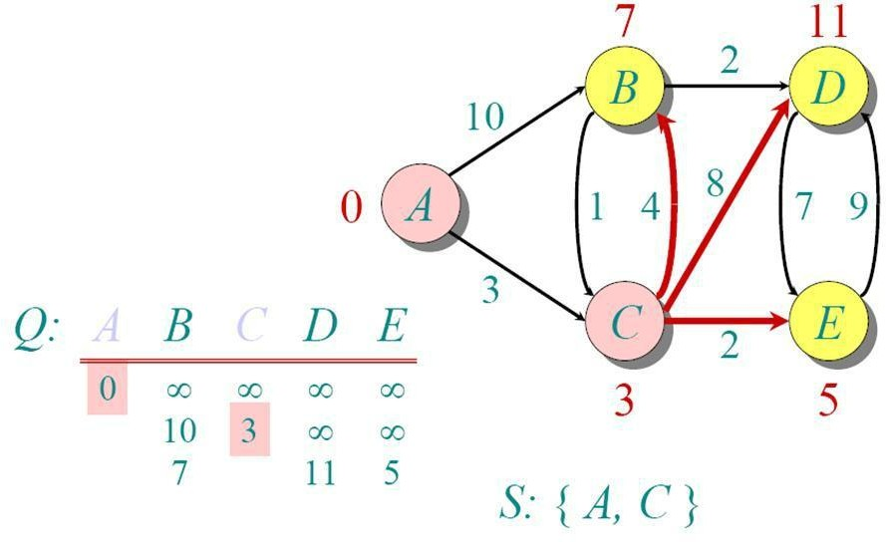
Dijkstra Example
66

Slide 70
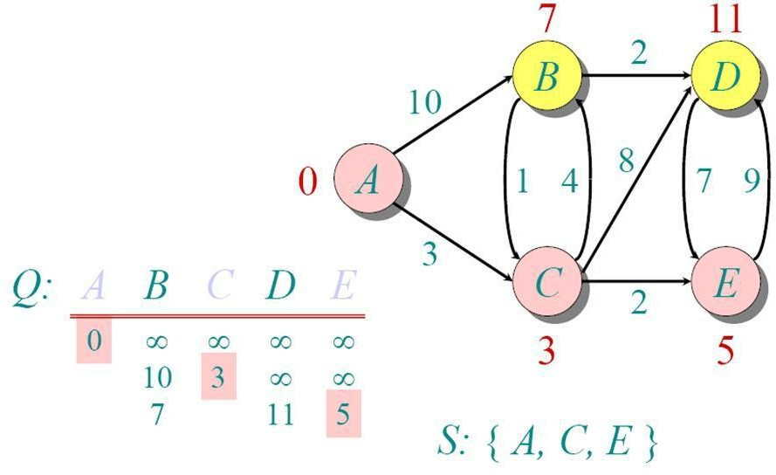
Dijkstra Example
67

Slide 71
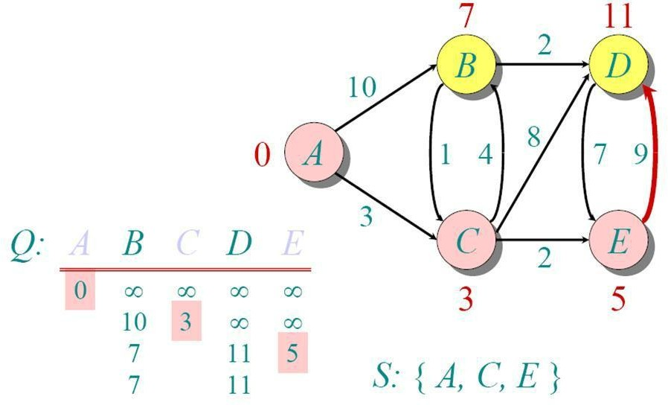
Dijkstra Example
68

Slide 72

Dijkstra Example
69

Slide 73

Dijkstra Example
70

Slide 74

Dijkstra Example
71

Slide 75

Applications of Dijkstra's Algorithm
Traffic Information Systems
Mapping (Map Quest, Google Maps)
Routing Systems
72

Slide 76
References - Dijkstra's Algorithm
◼ Dijkstra’s original paper:
E. W. Dijkstra. (1959) A Note on Two Problems in Connection with Graphs. Numerische Mathematik, 1. 269-271.
73

Slide 77

Practice Example:
Find shortest path using Dijkstra's Algorithm
Distance(source) | 0 |  |  | ∞ | Distance (all
= 0 | A |  | 2 | B | vertices but
∞ C | 4 | 1 |  | 3 | 10 source) = ∞
 | 2 |  | D | 2 | E ∞
 | 5 | 8 | ∞4 |  | 6
F
1
G
∞
∞
Pick vertex in List with minimum distance.
74

Slide 78
Topological Sort
Introduction.
Definition of Topological Sort.
Topological Sort is Not Unique.
Topological Sort Algorithm.
An Example.

Slide 79

Introduction
There are many problems involving a set of tasks in which some of the tasks must be done before others.
For example, consider the problem of taking a course only after taking its prerequisites.
Is there any systematic way of linearly arranging the courses in the order that they should be taken?
Yes! - Topological sort.

Slide 80

Definition of Topological Sort
◼ Topological sort is a method of arranging the vertices in a directed acyclic graph (DAG), as a sequence, such that no vertex appear in the sequence before its predecessor.
(a)
(b
)

Slide 81

Topological Sort is not unique
Topological sort is not unique.
The following are all topological sort of the graph below:
s1 = {a, b, c, d, e, f, g, h, i}
s2 = {a, c, b, f, e, d, h, g, i}
s3 = {a, b, d, c, e, g, f, h, i}
s4 = {a, c, f, b, e, h, d, g, i} etc.

Slide 82
Topological Sort Algorithm
One way to find a topological sort is to consider in-degrees of the vertices.
The first vertex must have in-degree zero -- every DAG must have at least one vertex with in-degree zero.
The Topological sort algorithm is:
From a given graph find a vertex with no incoming edges.
Delete it along with all the edges outgoing from it.
If there are more than one such vertices then break the tie randomly.
Note the vertices that are deleted.
All these recorded vertices give topologically sorted list

Slide 83
Topological Sort Algorithm
int topologicalOrderTraversal( ){ int numVisitedVertices = 0;
while(there are more vertices to be visited)
{
if(there is no vertex with in-degree
0) break; else{
select a vertex v that has in-degree 0; visit v;
numVisitedVertices++;
delete v and all its emanating edges;
}
}
return numVisitedVertices;
}

Slide 84

Topological Sort

Slide 85




Topological Sort Example
1
A
2
B
3
C
0
D
2
E
F | G | H | I | J
1 | 0 | 2 | 2 | 0
D G A B F H J
E I C

Slide 86
Contents
Basic concepts
Operations
Graphs storage structures
Traversals: Depth First and Breadth First.
Graph algorithm
Graph as an ADT
Minimum spanning trees: Kruskal’s and Prim’s.
Algorithm for shortest path
Topological sorting

Slide 87
END OF UNIT II
84

